Slide 1
Controlling Vision-Language Models for Universal Image Restoration
Ziwei Luo, Fredrik K. Gustafsson, Zheng Zhao, Jens Sjolund, Thomas B. Schon
Department of Information Technology, Uppsala University
ICLR 2024

Slide 2
Introduction - Problem Statement
Challenge:
VLMs excel in high-level understanding but struggle with low-level vision tasks like image restoration.
They lack the fine-grained features needed for tasks like deblurring, denoising.
Limitations of Current Methods:
Most restoration models are designed for specific degradation types, requiring multiple models for different tasks, reducing scalability.

Slide 3
Introduction - Motivation
Why DA-CLIP?
Uses trainable image controllers to adapt large-scale pre-trained VLMs to low-level vision tasks.
Leverages contrastive learning to align content and degradation features, enabling accurate feature extraction from corrupted inputs.
Introduces Prompt Learning Module to leverage degradation context, allowing the model to handle multiple degradation types.
Focuses on both semantic consistency and detail recovery.

Slide 4
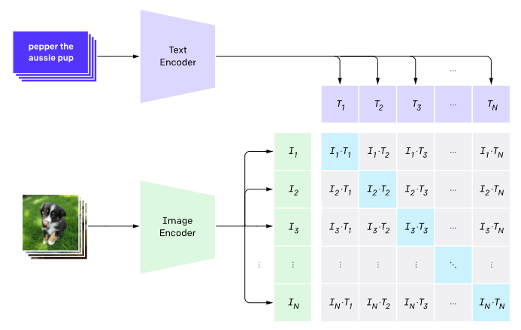
Related Works - CLIP
Aligns text and image embeddings in a shared semantic space with
strong language understanding.
Cons:
Lacks fine-grained low-level
feature recovery.

Slide 5
Related Works - DDPM
Generates high-quality images by progressively denoising random noise.
Cons:
Lacks semantic understanding.
Extension to IR-SDE
IR-SDE removes self-attention and adds cross-attention to allow semantic guidance during the denoising process.

Slide 6
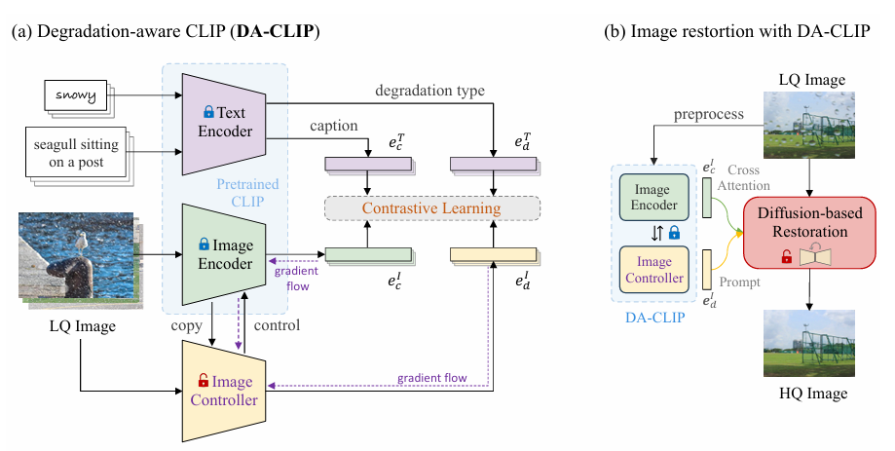
Method--Overview
Degradation aware CLIP(DA-CLIP):
Train an additional Image Controller to adapt the frozen CLIP image encoder for different type of degradation.
Restoration with DA-CLIP: Use LQ to predict
Clean image content
LQ Degradation type
And merge as condition for diffusion model

Slide 7
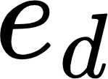
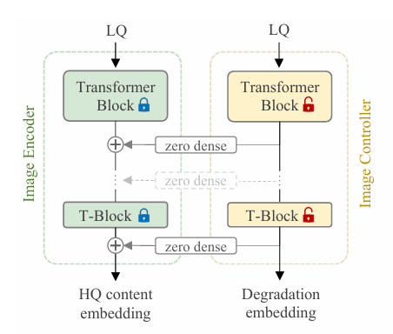
Method--Degradation aware CLIP
Image Controller
Copy from Image Encoder
Control and Predict:
Control by add to intermediate layer of encoder
Predict the Degradation embedding
Contrastive Learning
Optimizes controller to align both content and degradation embeddings .

Slide 8
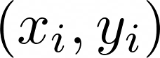
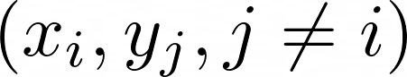

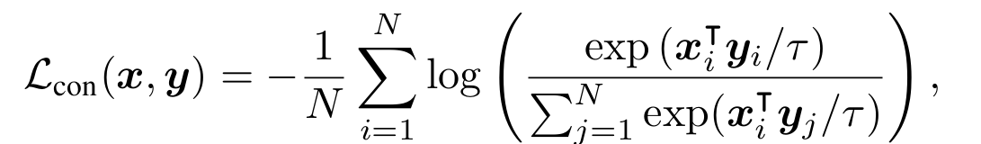
Method--Degradation aware CLIP
Contrastive Learning (Supp)
Minimizes distance between matching pairs and maximizes distance with non-matching pairs
is learnable temperature for contrastive strength

Slide 9
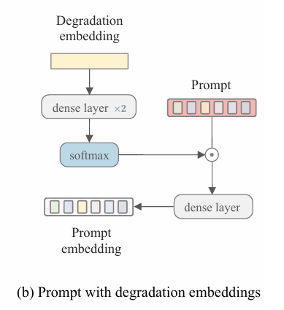
Method--Image Restoration with DA-CLIP
Base on IR-SDE (Diffusion Based Model)
Can adapt to non-diffusion model
Prompt Learning from degradation embedding
Given degradation embedding, learn prompt tokens and output prompt embedding
Using Cross Attention to merge content embedding and prompt embedding, as condition for backbone model

Slide 10
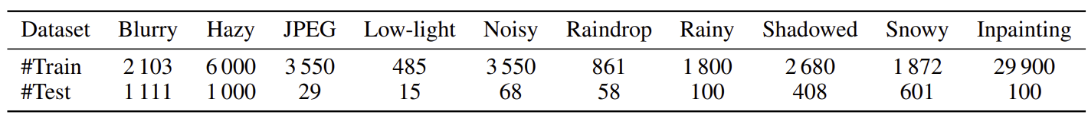
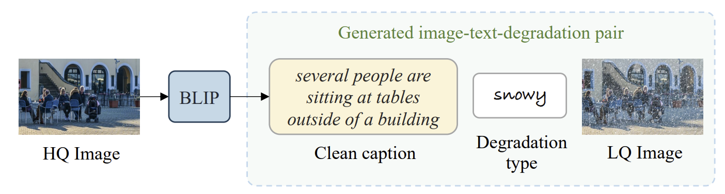
Experiment
Dataset Construction
Synthetic Multi-Degradation Dataset:
10 different image degradation types
Each image is paired with a synthetic caption

Slide 11
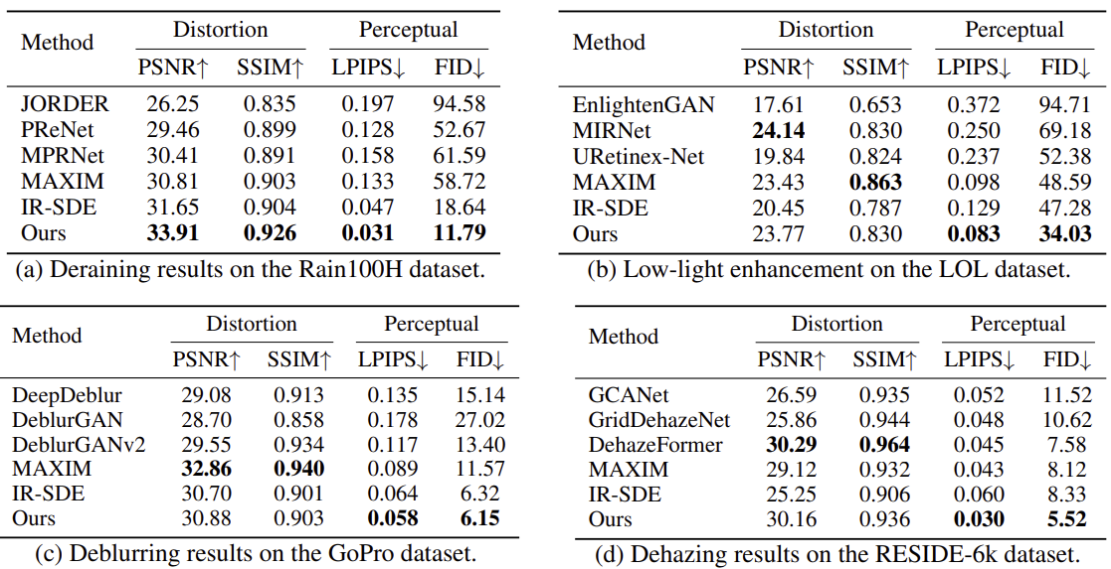
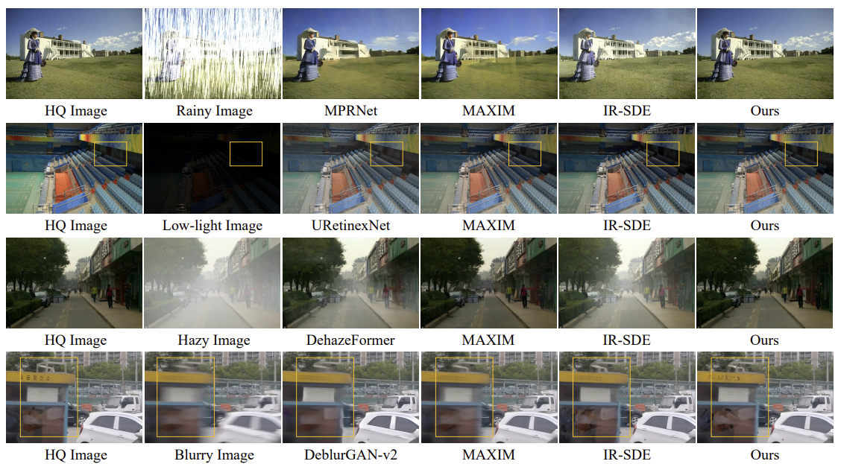
Experiment
Evaluation & Comparison
Degradation-Specific Restoration
Tasks: Rain (Rain100H), Low-light (LOL), Blur (GoPro), Haze (RESIDE-6k)

Slide 12
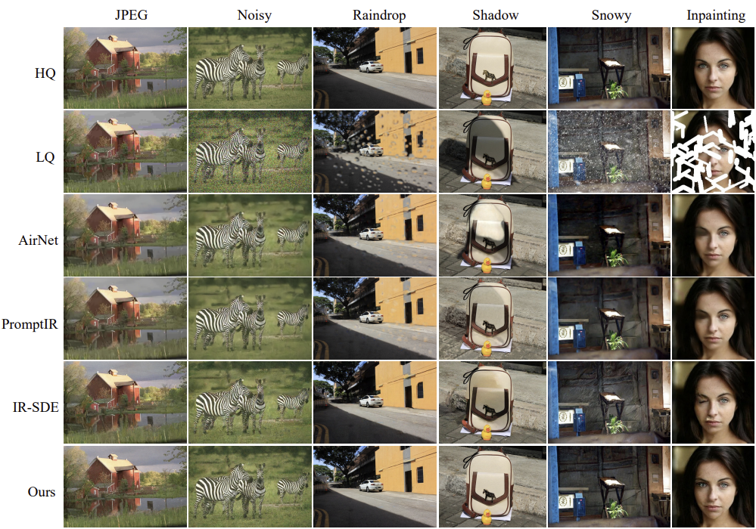
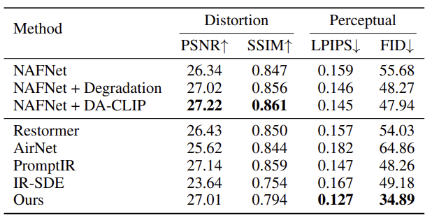
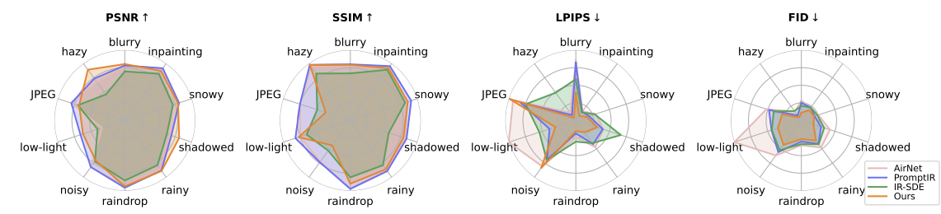
Experiment
Evaluation & Comparison
Unified Multi-Degradation Restoration
Single model trained to handle all 10 degradation types

Slide 13
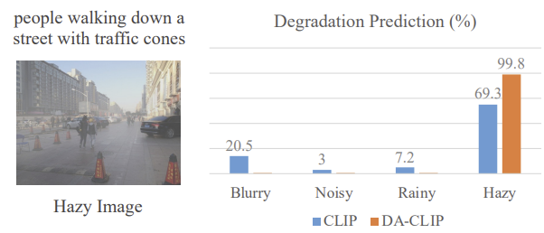
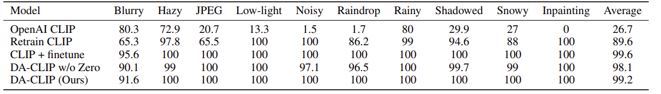
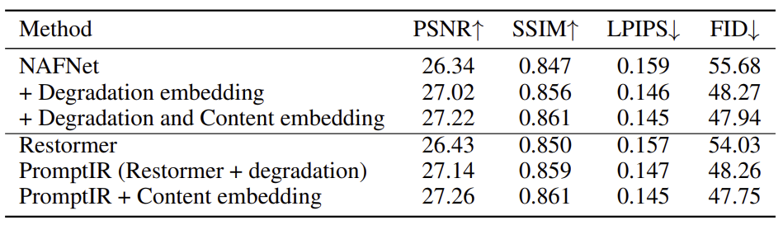
Experiment
Ablation Study
Degradation Classification:
DA-CLIP (zero-init controller) achieves 99.2% classification accuracy
DA-CLIP improves MSE-based models like Restormer and NAFNet
Degradation embedding & content embedding are both critical

Slide 14
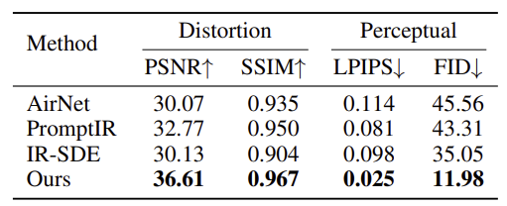
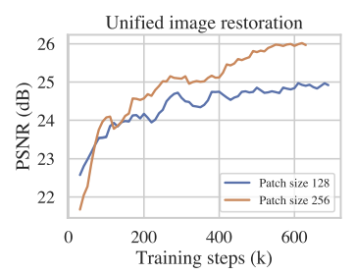
Experiment
Additional Analysis
Out-of-Distribution Generalization
Robustness to Unseen Degradations
Evaluated on Rain100L (light rain), unseen during training
Patch Size Impact
Larger patch size (256×256) leads to better convergence
Limitations:
Increased memory usage
Each image has one label — cannot yet handle multiple simultaneous degradations

Slide 15
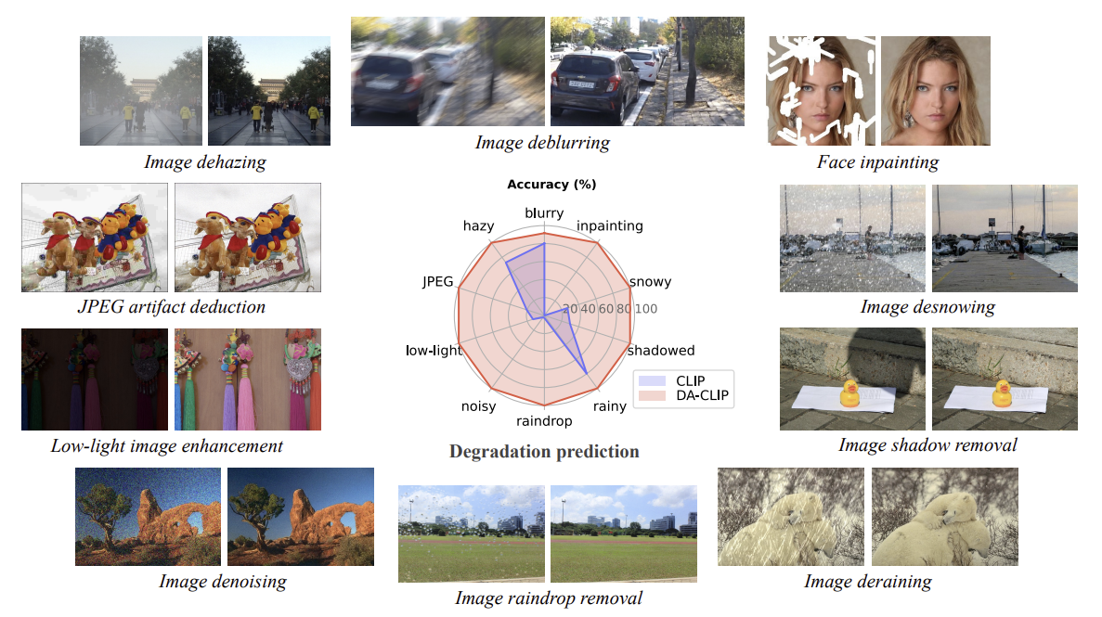
Conclusion
DA-CLIP bridges vision-language models and low-level restoration tasks
Outperforms baselines on both single-task and unified settings
Improves both diffusion- and regression-based models
Future work:
Multi-degradation training
Instruction-based restoration
Explore stronger VLMs

Slide 16
Thanks you! Q&A

